Slide 1
AI Applications in People Management
Course Introduction
Peter Cappelli, George W. Taylor Professor of Management and Director of Wharton’s Center for Human Resources

Slide 2
Course Introduction
Managing people is a huge task
2/3rd of all costs come from employees or labor of various kinds
66 million hires per year
Manage performance, pay, careers, benefits
Vendor industry of $½ trillion
Almost the size of the entire US construction industry

Slide 3
Course Introduction
People management issues affect company brand — sexual harassment, diversity issues, etc.
Competencies in strategy – how do we get good at something?
Managing people affects their lives — managing them badly is a key cause of health problems

Slide 4
What is AI?
Data science — engineering approach to data
Data science is particularly applying statistics and related data analysis tools to questions of optimization
Supply chains
Optimal scheduling with truck fleets
Theory X vs. Theory Y
Is it better to tell employees what to do or ask them what to do?
Fairness matters
Embodied in law, regulations about all aspects of employment

Slide 5
Why is Introducing Data Science So Challenging Here?
Change management
We have organizations that have been doing things one way and we want them to change
Before applying data science, we have an intricate, messy system for managing employees
Change is really hard here — we have a complicated system, in which people are deeply invested already, and we are asking them to do things differently

Slide 6
Big Opportunity
We don’t do all that well right now
There’s a lot of room for improvement

Slide 7
AI Applications in People Management
Uniqueness of HR Challenges
Peter Cappelli, George W. Taylor Professor of Management and Director of Wharton’s Center for Human Resources

Slide 8

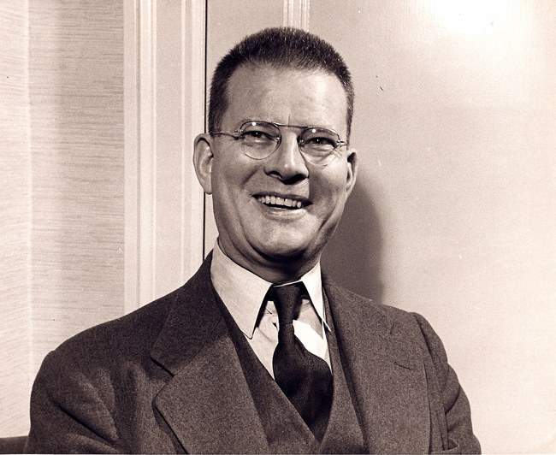
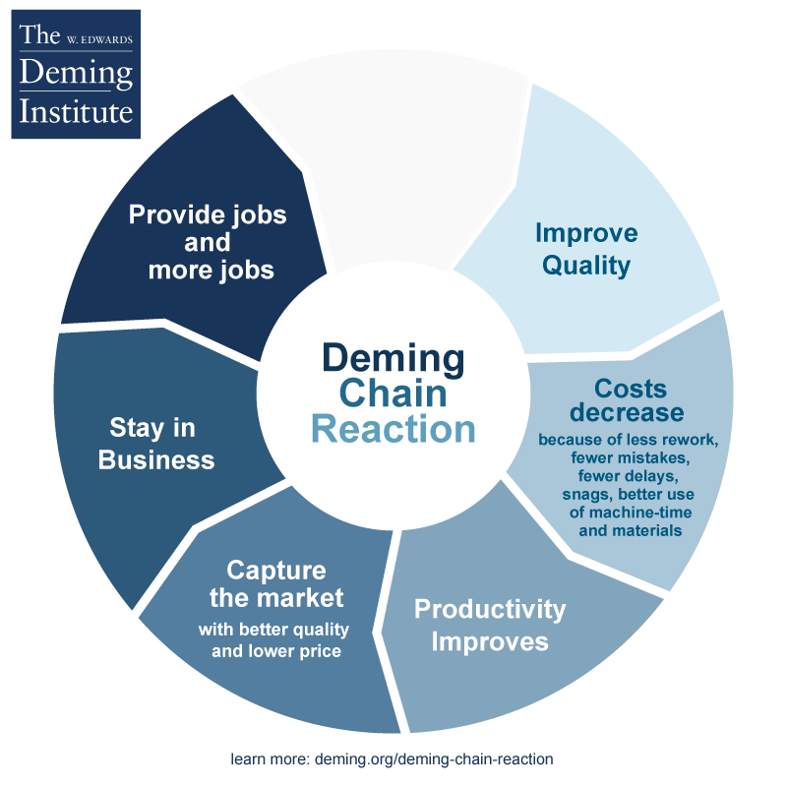
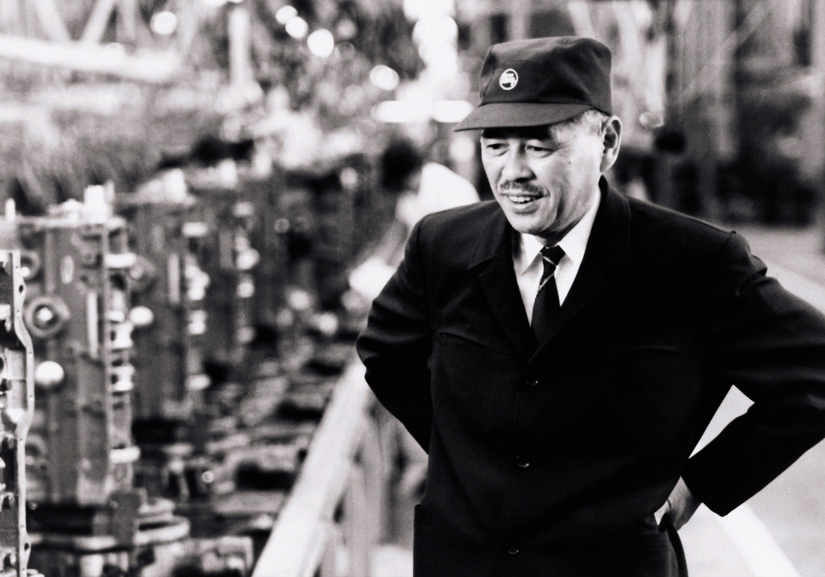


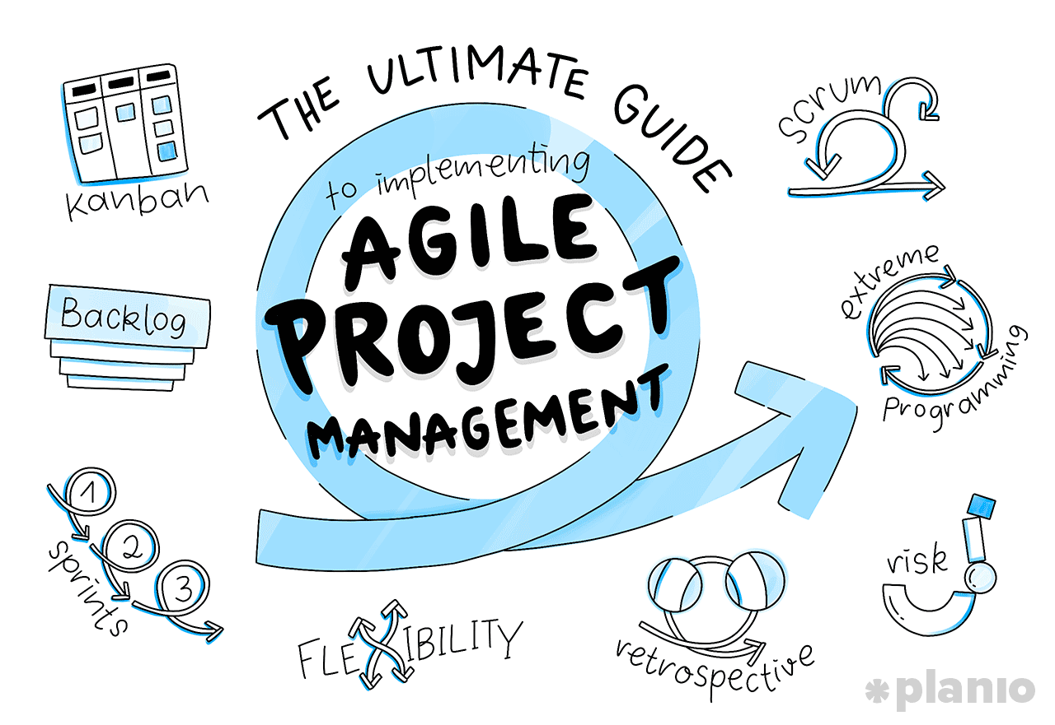

The Slow Climb of the Theory Y Argument
Edwards Deming
Baldwin Locomotive Works
Taiichi Ohio
Toyota Motor Corporation
Elton Mayo
Western Electric Co.
Hawthorne Works
Ford Motor Company
Assembly Line

Slide 9
Some Issues Affecting Employee Motivation
How do we pay them?
How do we measure their performance?
Relative pay compared to other people
Perceived contribution vs. others, relative to pay
Fairness question

Slide 10
People Management Concerns Outside of Performance
Demographic balance of the workforce (diversity inclusion)
Public perception of our workforce practices
Want to be seen as a good employer and a desirable place to work
Compliance

Slide 11
Data Science in People Management
Optimization
We can optimize on one outcome at a time
Requires a lot of data
Mistakes are made at scale and are obvious
When we introduce data science models that tell us how to make decisions, we’re taking those decisions away from employees and supervisors
What happens when we make that transition?
Where will it make things better and where might it make things worse?

Slide 12
AI Applications in People Management
HR Without AI
Matthew Bidwell, Associate Professor of Management

Slide 13
Introduction
Managing people is complicated
Course goal — describe how new technologies around artificial intelligence and machine learning can create new opportunities to find better ways to manage people

Slide 14
Traditional HR Challenges
Hiring is a fundamental process in managing people
Tug-of-war between structured processes, managerial discretion, and cost control

Slide 15
Hiring
Structured process
In hiring, we are trying to measure applicants’ potential — how good do we expect them to be?
Best practices that organizations try to employ in hiring
Structured interviews (important attributes identified, pre-determined questions, defined rubric)
Tests of cognitive ability and job knowledge
Personality tests

Slide 16
Hiring
Managerial discretion
Hiring managers often resist structured processes as a means to make hiring decisions
Stiff and formal
We form opinions of people quickly, and believe we are superb judges of character (we’re not)

Slide 17
Hiring
Cost control
You want to hire the right people, but you also want to do it efficiently
Organizations worry about:
Cost per hire (ads, recruiter time, etc.)
How long it takes to fill the job
Organizations will also try to determine quality of hire
Surveys of supervisors
Attrition

Slide 18
AI Applications in People Management
Managing Engagement without AI
Matthew Bidwell, Associate Professor of Management

Slide 19
Traditional HR Challenges
Engagement
The need to motivate people is something that differentiates the management of people from any other part of the organization
Fundamental to getting it right, is knowing how engaged people are in the first place
Standard way to achieve this is through employee engagement surveys

Slide 20
Engagement
Employee engagement surveys
Many companies will survey employees annually
Often tend to use specific sets of questions (often called “scales") developed by psychologists to clearly tap into specific opinions about each of the attributes they care about in their work

Slide 21
Engagement
Employee engagement surveys
Can give a good sense of how well we are doing overall
Can examine trends from one year to the next
Can look across different groups
Often a gap between what people are thinking and what they tell you they are thinking
People might not always tell the truth — “Are you paid enough?” is always “No”
Can be worries about retaliation
Expensive, difficult to get people to fill out, and only once a year

Slide 22
AI Applications in People Management
Managing Attrition without AI
Matthew Bidwell, Associate Professor of Management

Slide 23
Traditional HR Challenges
Attrition
Firms care a lot about turnover
Reflects high cost of replacing people who leave
Disruption to business
Loss of knowledge
There are a lot of levers we can pull to address attrition, but we need to know which ones we should pull
Need to figure out why people are leaving

Slide 24
Attrition
Approaches to understanding and tracking attrition
Track attrition rates
The number of people who leave in a given time period divided by the number of people you employed at the beginning of that period
Can be over 100%
By looking at where attrition is higher, we can start to get some idea of what might be driving it
Exit interviews

Slide 25
Summary
Given the critical importance of employees to the functioning of any organization, firms have put serious thought over the years into how they can track basic dimensions of the employment relationship and ways that they can improve it
Each approach has limitations
Employees are complex and every one is unique
Some attributes are hard to measure (particularly attitudes)
Getting data is costly
Often rely on managers and supervisors who may have their own biases or agendas

Slide 26
Summary
New technologies have created opportunities to do things differently — to find new ways to assess, measure and manage these important aspects of employment
They don't solve every problem, but they do provide complementary approaches

Slide 27
AI Applications in People Management
Decision Making
Prasanna (Sonny) Tambe, Associate Professor of Operations, Information and Decisions

Slide 28
Decision Making
Machine learning is a way to take data and to algorithmically arrive at a prediction
A prediction is a recommendation
For instance:
Invite candidate for an interview
Promote an employee
Recommend a benefit

Slide 29
How Machine Learning Works
Consider a progression from human decision making to machine learning
Human decision making
Rule-based systems
Machine learning

Slide 30
Decision Making
How do people make decisions?
We use our knowledge and experience to develop heuristics
This is especially true of rapid decisions when information is imperfect
Human resources (HR) is a great example

Slide 31
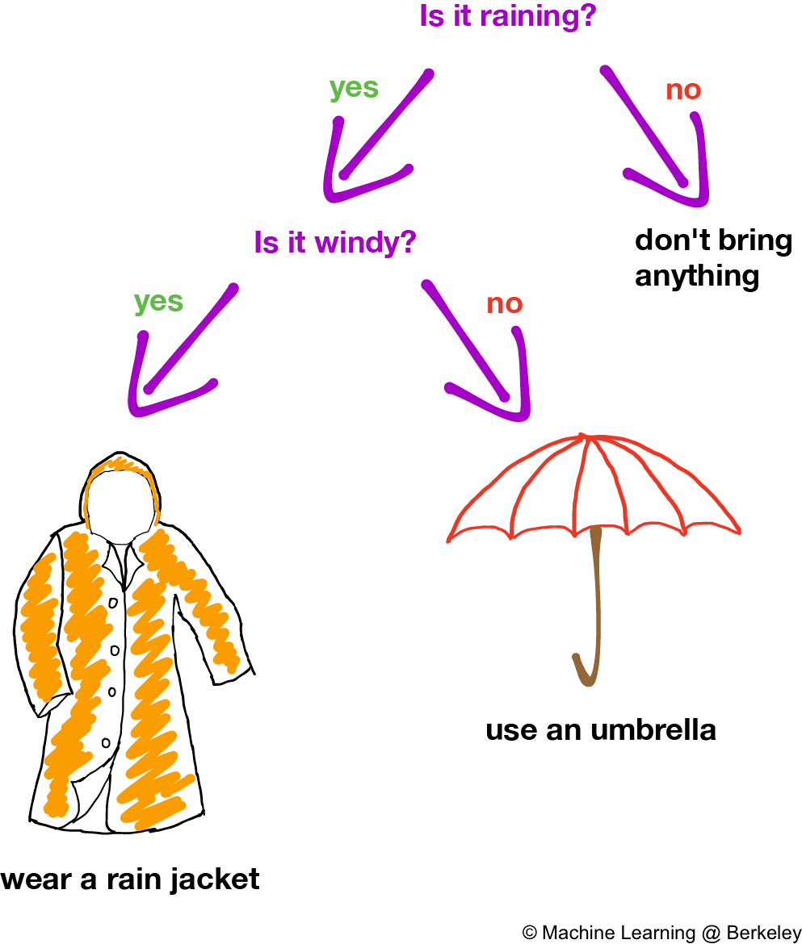
Decision Tree

Slide 32
Decision Tree
Imagine you have a stack of resumes to evaluate
What tree might you create?
What factors would it include?
Requires experience related to hiring, your specific organization, and so on

Slide 33
Decision Tree
Drawbacks of this approach
Time consuming
Noisy, imperfect
Biases

Slide 34
AI Applications in People Management
Rule-based Systems
Prasanna (Sonny) Tambe, Associate Professor of Operations, Information and Decisions

Slide 35
Rule-based Systems
Rule-based (expert) systems encode an expert’s knowledge and skill into a software-based model
Convert conditions into a series of if/then rules
Similar to an “expert” writing down all of their knowledge and a developer converting it into software

Slide 36
Rule-based Systems
Recruiting example
You may have a set of conditions, including school, GPA, prior employer, interview styles, etc.
Some of these can be coded from a resume or interview data
No data is needed - you are only encoding human expertise

Slide 37
Rule-based Systems
Some limitations
We need access to an expert
May be hard to get access to an expert
Difficult to ask people to explain everything they know about a field
Cannot easily update/learn when the environment changes
We need to know the relationships
Cannot discover new relationships
Tremendous amount of work to create a comprehensive knowledge tree

Slide 38
AI Applications in People Management
How Machine Learning Works
Prasanna (Sonny) Tambe, Associate Professor of Operations, Information and Decisions

Slide 39
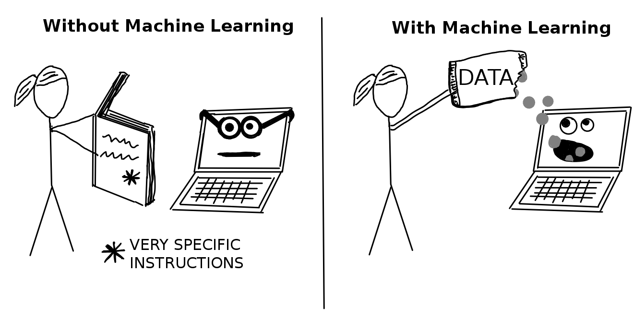
Machine Learning
Pattern recognition
Uses examples (“training data”) to generate the decision framework
The key is that machine learning is about showing, not telling
Completely changes the work flow — starts with the data, not the expertise

Slide 40
Machine Learning is Transformative
Why is this better?
It changes the workflow
Can handle large amounts of data with accuracy
Scale
Consistency

Slide 41
AI Applications in People Management
The Role of Training Date in Machine Learning
Prasanna (Sonny) Tambe, Associate Professor of Operations, Information and Decisions

Slide 42
The Role of Training Data in Machine Learning
The key to machine learning is the availability of training data (examples)
An algorithm uses the training data to learn the correct mapping function between the information it’s being fed and the final prediction (outcome) that it’s going to arrive at
Labeled data are examples that can be used to teach the machine
They illustrate the right answer for different conditions
The resurgence in AI, specifically around machine learning, has been driven by the ever-expanding availability of large sources of training data

Slide 43
The Role of Training Data in Machine Learning
For HR applications, training data can come from a number of places
Archival data
Human data labeling/platforms

Slide 44
The Role of Training Data in Machine Learning
Example: X-rays
Provide examples of x-ray images along with decisions that doctors historically made about patients with those images

Slide 45
Summary
Expert systems require no data, but require an expert to specify how inputs map to decisions
Machine learning requires no experts, but requires training examples that an algorithm can use to find the correct mapping

Slide 46
AI Applications in People Management
Feature Engineering: Beyond Structured Data
Prasanna (Sonny) Tambe, Associate Professor of Operations, Information and Decisions

Slide 47
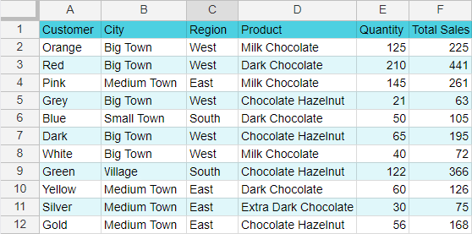
Data are Not Always Nicely “Structured”
Decision

Slide 48
Machine Learning with Unstructured Data
“Unstructured” data
Online reviews
Diagnostic images
Resumes
Features have to be “engineered” from the data
A time consuming and challenging process
Often requires domain expertise

Slide 49
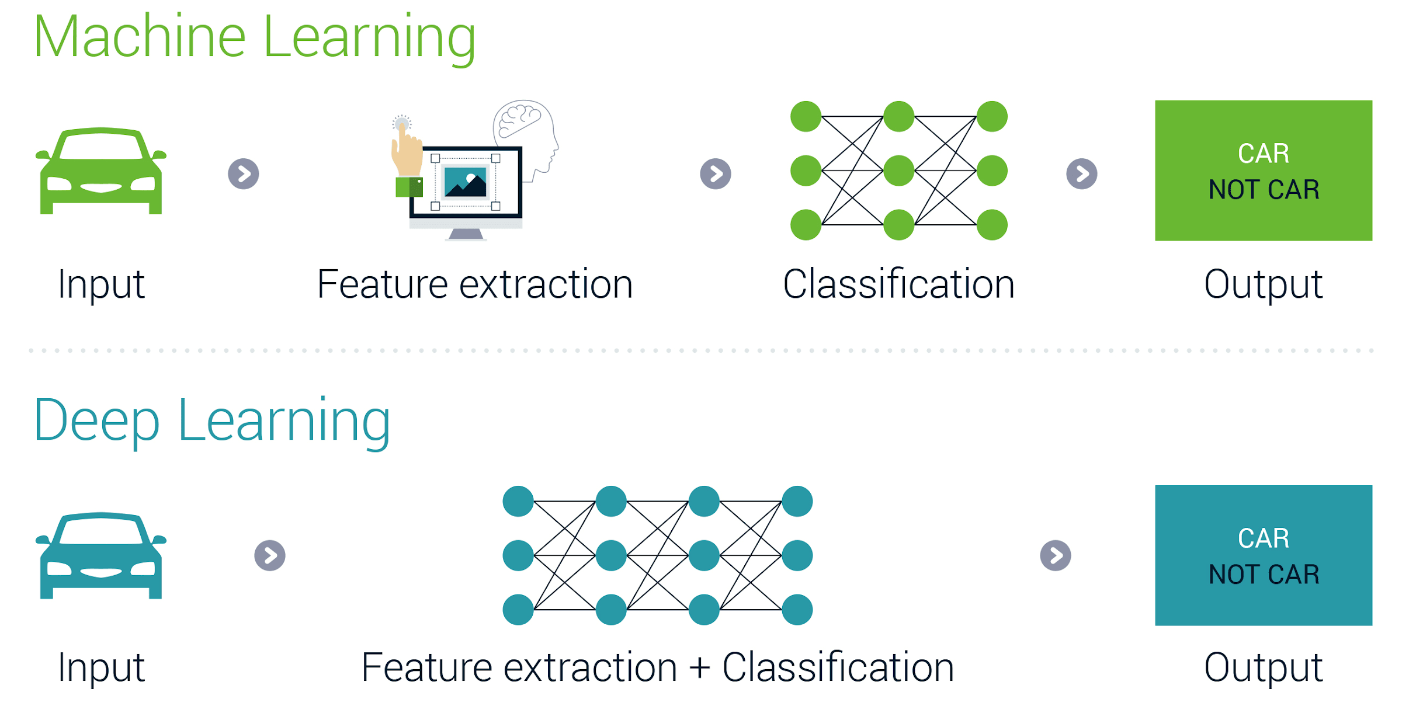
Machine Learning with Unstructured Data

Slide 50
AI Applications in People Management
Evaluating Machine Learning Performance
Prasanna (Sonny) Tambe, Associate Professor of Operations, Information and Decisions

Slide 51
What is Good Performance?
There are many ways to measure machine learning performance
Accuracy, precision, recall, specificity
Prediction is embedded in a business context, and different errors have different costs and benefits

Slide 52
What is Good Performance?
“I want to make absolutely sure I don’t miss any potentially good candidates”
Priority is to make sure that strong candidates are predicted as “strong”
“I don’t want to waste anyone’s time with a candidate who turns out to be bad”
Priority is to make sure no weak candidates are accidentally predicted as “strong”

Slide 53
Key Question
What are the relative costs of false negatives and false positives?
Is it more “expensive” to miss a good candidate or to waste staff time with a bad one?

Slide 54
AI Applications in People Management
End to End Example
Prasanna (Sonny) Tambe, Associate Professor of Operations, Information and Decisions

Slide 55
End-to-end Example
Automating the process of going from candidate application to an interview
First, gather historical data on prior (good) decisions
I don’t need to know about about HR or the organization
Resume data, test scores
Video data, audio transcripts
As long as we have strong “labels,” we don’t have to know how audio might relate to candidate performance — machine learning figures it out
With modern machine learning, the more data the better

Slide 56
End-to-end Example
Automating the process of going from candidate application to an interview
Second, specify model and decide what is is we are trying to optimize — what the error structure is
Run and optimize the model to perform well on out-of-sample data using the metrics to care about
Third, deploy
You can now start to run predictions on input data for candidates where we don’t know the answer

Slide 57
End-to-end Example
Start with historical data
Use the data to train the machine learning algorithm and make sure it performs well
Deploy

Slide 58


